Slide 1
DIGITAL MARKETING
APTECH NORTH

Slide 2


What is Marketing?

Slide 3


Slide 4
Process of Marketing
Creating (To Create)
Communicating (Btana)
Delivering (Pohchana)
Exchanging (get something in return)
Offering (customer ko value dena or lena)

Slide 5
Creating Value
What customer wants. Customer ko kya chahiye usko dekh k company products bnati hai.

Slide 6
Communicating Value
Product to bnali mgr customer ko to pata hi nhi k produt kaisi haai.
Convey effective message to customers.

Slide 7
Delivering Value
Product ban gai or customer ko bhi bta dya ab customer ko bhi to pohcahna haai either online or offline.
Delivering value is the job of an organization.
Delivering tk k steps ko marketing kehty hein.

Slide 8

Exchanging Value
Company ko usky paisay mil gaye or customer ko
uska product.

Slide 9
Offering Value
Business ka maqsad is not only earn money customer satisfaction is also important.
Your customer is your ambassador.

Slide 10
Evolution of marketing
TRADE ERA
Barter system (dosra aysa kya produce kr raha hai jiska mjhe faida hoskta hai)
PRODUCTION ERA(1860-1910)
Factories and Machines are manufactured.
For e.g focus on production marketing how to icrease production in factories.
SALES ERA(1920-1930)
Focus on sales marketing for e.g hire sale persons and give them information about your product.

Slide 11
Contd…
MARKETING ERA(1940-1950)
They come to know that selling & production is not only marketing.
Focus on branding like broachers, pamphlet are invited in this era this is also named as brand development.
MARKETING COMPANY (1960-1990)
Production, sales & brand development k log ek sath bethy or decide kara k agr humein achi profitibilaty chahiye to hamein ek sath kam krna parega.
RELATION ERA (1990-2000)
Customer k pass options bht zyada hein to srf selling or branding kaam nhi arahi. So, they decide to become in relationship with customers.

Slide 12
Contd…
SMM ERA
Jb digital companies aam hogai to companies ne digital marketing start krdi
Or fb,yt,ig etc pe customers k sath relationship shuro krdi.

Slide 13
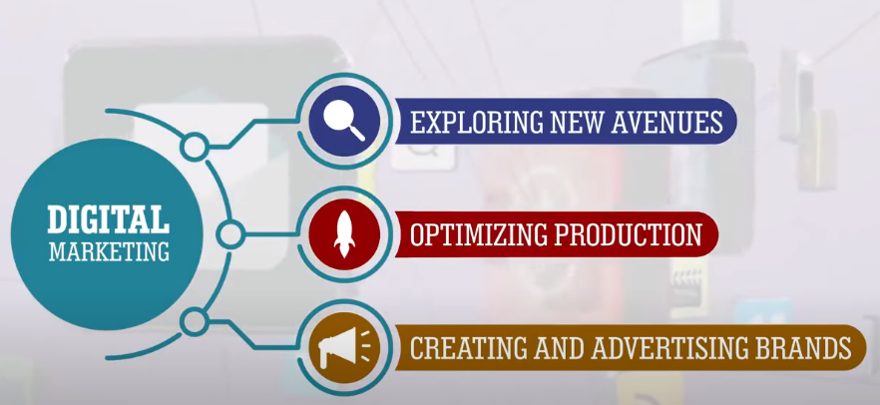
What digital marketing provides to company?
EXPLORING NEW AVENUES
Ap opportunities ko dekhty
hein or new opportunities ko
Search krty hein.
Optimizing Production
Production ki efficiency ko
behtar krny k lye marketing apna
kirdar ada kr raha hai.
CREATING & ADVERTISING BRANDS
You choose themes & colors of
Your brand for recognized your
company by customers.

Slide 14
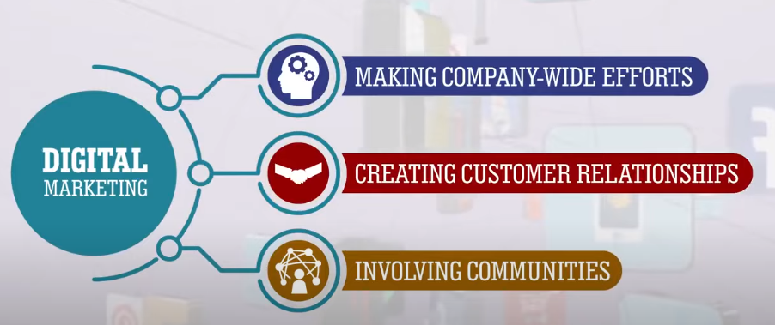
Contd…
MAKING COMPANY-WIDE EFFORTS
Poori company ko ek goal k lye
kaam krna hai. For e.g agr apki
honey ki company hai or apki
tagline hai k hamari honey sbse
sweet haai to apka salesperson
bhi sweet hona chahiye.
CREATING CUSTOMER RELATIONSHIP
Agr customer ko satisfy krdya to
customer kahin or se nhi lega
product.
INVOLVING COMMUNITIES
Jb customer satisfy hojata hai apki
product se to who dosray ko
btayega to ek community bn jaegi.

Slide 15
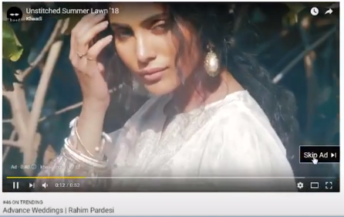
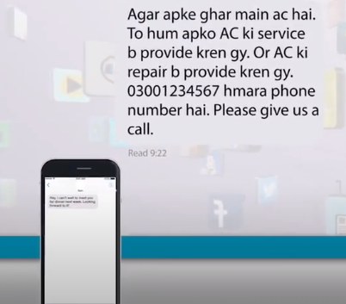

What is Digital Media?

Slide 16
Definition & Features of Digital Media
Digital media is refers to audio, video, photo or text content witch develop on computer and transmitted to the peoples.
Features Of Digital Media
MASS REACH
Company apna message lakhon croron tk pohoncha saky ek click k zriye.
INTERACTIVITY
Customer/audience live apse interact ho skta hai.
SOCIAL NETWORKING
Blogs and forums to communicate with peoples.

Slide 17

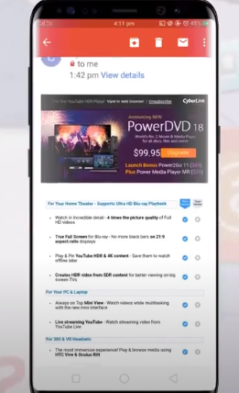
Examples of Digital Media
SOCIAL MEDIA PLATFORMS
WEBSITES
Puts ads, messages on website to gain customers.
EMAIL AND SMS

Slide 18

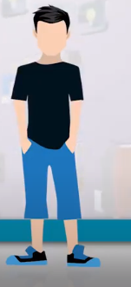
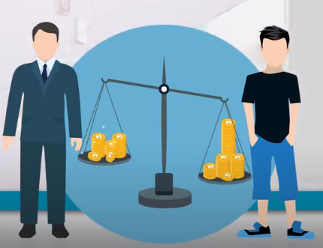
What is Digital Marketing?

Slide 19
Definition
All marketing activities done on modern digital channels.
Digital Marketing Includes
PAID ADS
SMM
MOBILE MARKETING(email,WA,sms,viber etc)
SEO
MOBILE MARKETING(all apps)
MARKETING RESEARCH(collect data on given topic and create report on that topic)

Slide 20
Power of Digital Marketing
Global REACH
PERSONALIZED MARKETING
CUSTOMER ENGAGEMENT
CONTENT VARIETY
COST REDUCTION

